Slide 1
Unit -4
Java Web Services

Slide 2
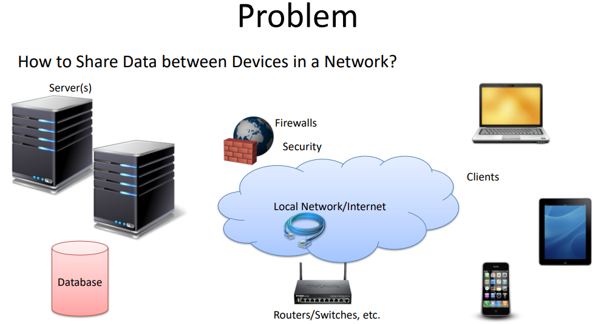

Slide 3
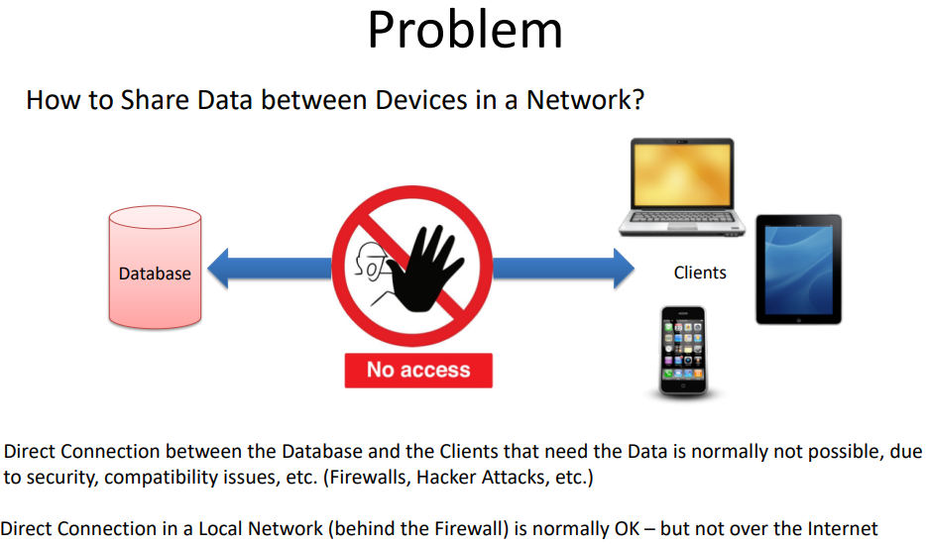

Slide 4
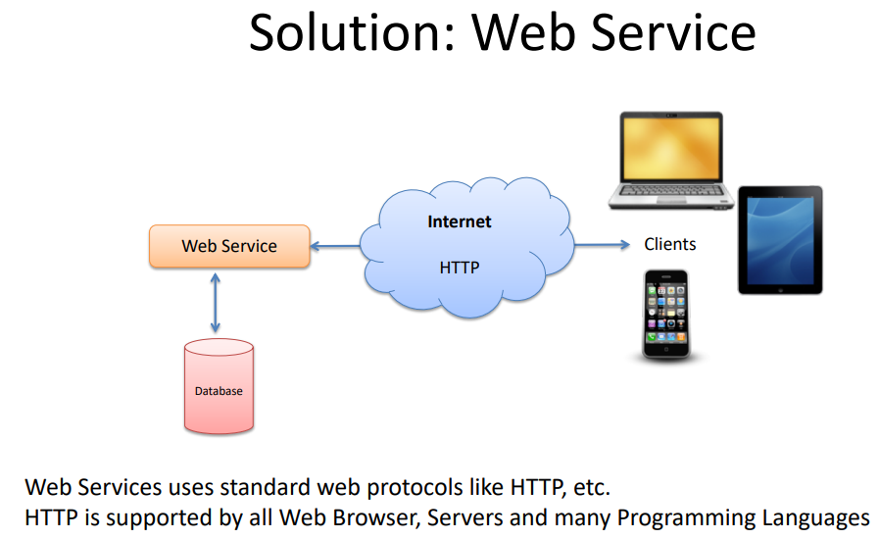

Slide 5
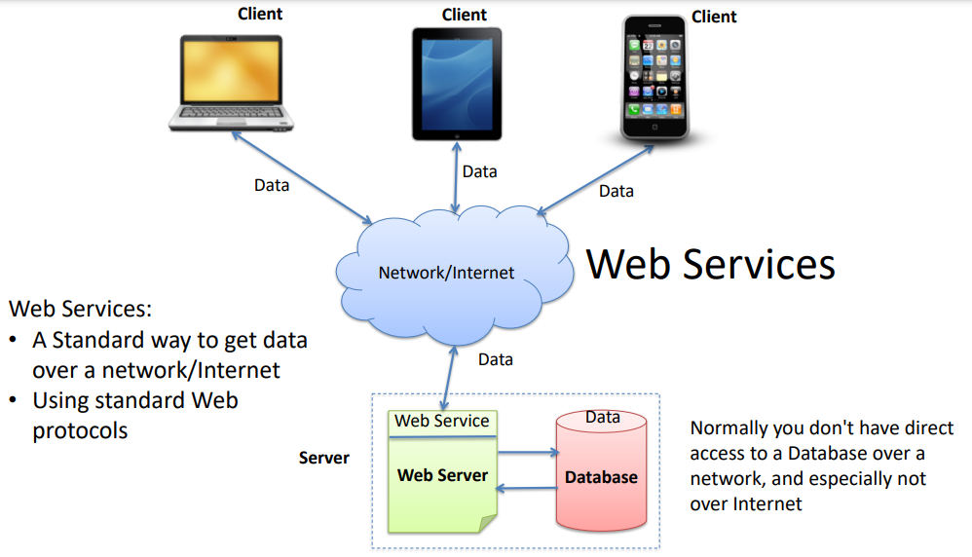

Slide 6
What is web service ?
Web services allow communication between different applications over the internet.
They enable interoperability between different programming languages and platforms.
Web services are XML-based information exchange systems that use the Internet for direct application-to-application interaction. These systems can include programs, objects, messages, or documents.
A web service is a collection of open protocols and standards used for exchanging data between applications or systems.

Slide 7
What is web service ?
In sort, a complete web service is, therefore, any service that −
Is available over the Internet or private (intranet) networks
Uses a standardized XML messaging system
Is not tied to any one operating system or programming language
Is self-describing via a common XML grammar
Is discoverable via a simple find mechanism

Slide 8
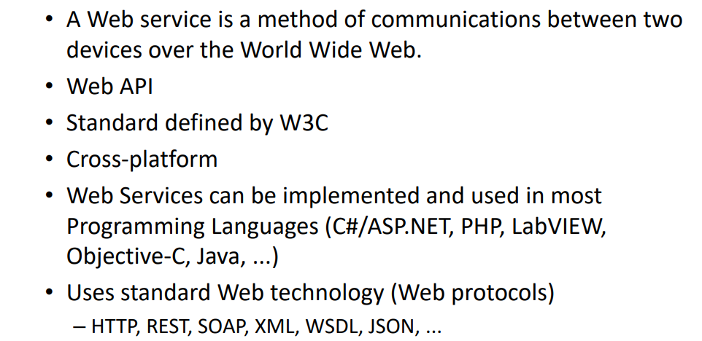
What is web service ?

Slide 9
Why Web Services?
Exposing the Existing Function on the network
Interoperability
Standardized Protocol
Low Cost Communication

Slide 10
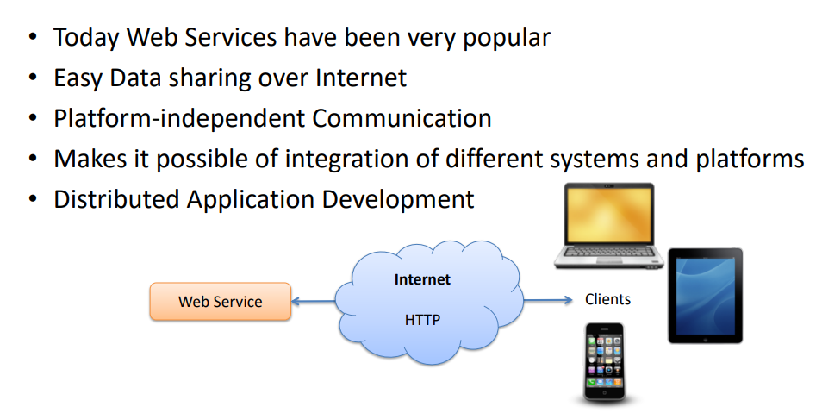
Why Web Services?

Slide 11
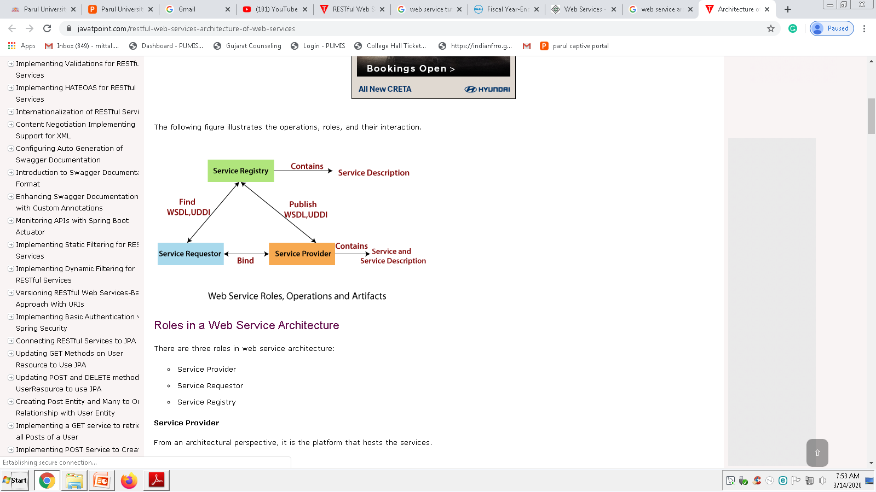
Architecture
Three Roles
Service Provider
Service Requestor
Service Registry
Operations in a Web Service Architecture
Publication of service descriptions (Publish)
Finding of services descriptions (Find)
Invoking of service based on service descriptions (Bind)

Slide 12
Architecture
Client: The application that sends requests to a web service.
Web Service: The server-side application providing functionalities.
Registry (UDDI): A directory for discovering web services.
Transport (HTTP, SMTP, FTP): The communication protocol used.
Messaging (SOAP, REST): Defines how data is formatted and exchanged.

Slide 13
continue..
The Web Services architecture describes how to instantiate the elements and implement the operations in an interoperable manner.
The architecture of web service interacts among three roles: service provider, service requester, and service registry.
The interaction involves the three operations: publish, find, and bind. These operations and roles act upon the web services artifacts.
The web service artifacts are the web service software module and its description.

Slide 14
continue..
The service provider hosts a network-associable module (web service).
It defines a service description for the web service and publishes it to a service requestor or service registry.
These service requestor uses a find operation to retrieve the service description locally or from the service registry.
It uses the service description to bind with the service provider and invoke with the web service implementation.

Slide 15
continue..
Service Provider
From an architectural perspective, it is the platform that hosts the services.
Service Requestor
Service requestor is the application that is looking for and invoking or initiating an interaction with a service. The browser plays the requester role, driven by a consumer or a program without a user interface.
Service Registry
Service requestors find service and obtain binding information for services during development.

Slide 16
Operations in a Web Service Architecture
Three behaviors that take place in the microservices:
Publication of service descriptions (Publish)
a service description must be published so that a service requester can find the service.
Finding of services descriptions (Find)
the service requestor retrieves the service description directly. It can be involved in two different lifecycle phases for the service requestor:
At design, time to retrieve the service's interface description for program development.
And, at the runtime to retrieve the service's binding and location description for invocation.

Slide 17
continue..
Invoking of service based on service descriptions (Bind)
In the bind operation, the service requestor invokes or initiates an interaction with the service at runtime using the binding details in the service description to locate, contact, and invoke the service.

Slide 18
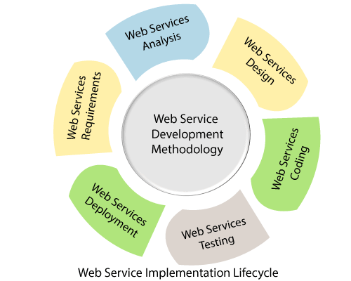
Web Service Implementation Lifecycle

Slide 19
Web Service Implementation Lifecycle
A web service implementation lifecycle refers to the phases for developing web services from the requirement to development. An Implementation lifecycle includes the following phases:
Requirements Phase
Analysis Phase
Design Phase
Coding Phase
Test Phase
Deployment Phase

Slide 20
Requirements Phase
The objective of the requirements phase is to understand the business requirement and translate them into the web services requirement.
The requirement analyst should do requirement elicitation (it is the practice of researching and discovering the requirements of the system from the user, customer, and other stakeholders).
The analyst should interpret, consolidate, and communicate these requirements to the development team.
The requirements should be grouped in a centralized repository where they can be viewed, prioritized, and mined for interactive features.

Slide 21
Analysis Phase
The purpose of the analysis phase is to refine and translate the web service into conceptual models by which the technical development team can understand.
It also defines the high-level structure and identifies the web service interface contracts.

Slide 22
Design Phase
In this phase, the detailed design of web services is done.
The designers define web service interface contract that has been identified in the analysis phase.
The defined web service interface contract identifies the elements and the corresponding data types as well as mode of interaction between web services and client.

Slide 23
Coding Phase
Coding and debugging phase is quite similar to other software component-based coding and debugging phase.
The main difference lies in the creation of additional web service interface wrappers, generation of WSDL, and client stubs.

Slide 24
Test Phase
In this phase, the tester performs interoperability testing between the platform and the client's program.
Testing to be conducted is to ensure that web services can bear the maximum load and stress.
Other tasks like profiling of the web service application and inspection of the SOAP message should also perform in the test phase.

Slide 25
Deployment Phase
The purpose of the deployment phase is to ensure that the web service is properly deployed in the distributed system.
It executes after the testing phase.
The primary task of deployer is to ensure that the web service has been properly configured and managed.
Other optional tasks like specifying and registering the web service with a UDDI registry also done in this phase.

Slide 26
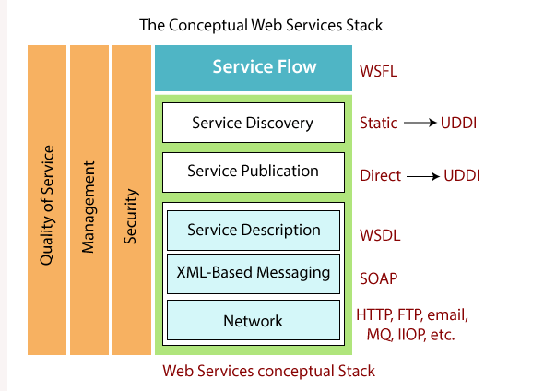
Web Service Stack or Web Service Protocol Stack

Slide 27
Web Service Stack or Web Service Protocol Stack
In the above figure, the top most layers build upon the capabilities provided by the lower layers.
The three vertical towers represent the requirements that are applied at every level of the stack.
The text on the right represents technologies that apply at that layer of the stack. A web service protocol stack typically stacks four protocols:
Transport Protocol
Messaging Protocol
Description Protocol
Discovery Protocol

Slide 28
(Service) Transport Protocol:
The network layer is the foundation of the web service stack. It is responsible for transporting a message between network applications.
HTTP is the network protocol for internet available web services. It also supports other network protocol such as SMTP, FTP, and BEEP (Block Extensible Exchange Protocol).

Slide 29
(XML) Messaging Protocol:
It is responsible for encoding message in a common XML format so that they can understand at either end of a network connection.
SOAP is the chosen XML messaging protocol because it supports three operations: publish, find, and bind operation.

Slide 30
(Service) Description Protocol:
It is used for describing the public interface to a specific web service. WSDL is the standard for XML-based service description.
WSDL describes the interface and mechanics of service interaction. The description is necessary to specify the business context, quality of service, and service-to-service relationship.

Slide 31
(Service) Discovery Protocol:
It is a centralized service into a common registry so that network Web services can publish their location and description.
It makes it easy to discover which services are available on the network.

Slide 32
Web Service Stack or Web Service Protocol Stack
The first three layers of the stack are required to provide or use any web service. The simplest stack consists of HTTP for the network layer, SOAP protocol for the XML-based messaging, and WSDL for the service description layer.
These three-layer provides interoperability and enables web service to control the existing internet infrastructure. It creates a low cost of entry to a global environment.
The bottom three layers of the stack identify technologies for compliance and interoperability, the next two layer- Service Publication and Service Discovery can be implemented with a range of solutions.

Slide 33
Web Service Features
XML-Based
Web services typically use XML (Extensible Markup Language) as the standard format for data exchange. XML provides a structured and platform-independent way to represent data, making it suitable for interoperability between different systems.

Slide 34
Web Service Features
Loosely Coupled
Web services are designed to be loosely coupled, meaning that the client and server components can evolve independently.
The client does not need to have prior knowledge of the server's implementation details, and changes in one component do not necessarily require changes in the other.
A tightly coupled system means that the client and server logic are closely tied to one another, indicating that if one interface changes, then another must be updated.
Accepting a loosely coupled architecture tends to make software systems more manageable and allows more straightforward integration between various systems.

Slide 35
Web Service Features
Coarse-Grained
Web services often follow a coarse-grained approach, where the operations exposed by the service deal with significant amounts of data or perform complex tasks. This reduces the number of remote calls needed, improving efficiency and performance.
Object-oriented technologies such as Java expose their functions through individual methods.
Web services technology implement a natural method of defining coarse-grained services that approach the right amount of business logic.

Slide 36
Web Service Features
Ability to be Synchronous or Asynchronous
Synchronicity specifies the binding of the client to the execution of the function. In synchronous invocations, the client blocks and delays in completing its service before continuing.
In asynchronous communication, the client can continue with other tasks while waiting for a response, improving scalability and responsiveness.

Slide 37
Web Service Features
Supports Remote Procedure Calls (RPCs)
Web services support remote procedure calls, allowing clients to invoke methods or functions on a remote server.
This enables the client to request specific operations or actions to be performed on the server, enhancing the interaction between distributed systems.

Slide 38
Web Service Features
Supports Document Exchange
Web services facilitate document exchange, allowing the transfer of structured information between different systems. This enables applications to share and collaborate on data, improving data integration and interoperability.

Slide 39
Types of web service
Two types
SOAP(JAX-RPC, JAX-WS)
RESTFUL(JAX-RS)

Slide 40
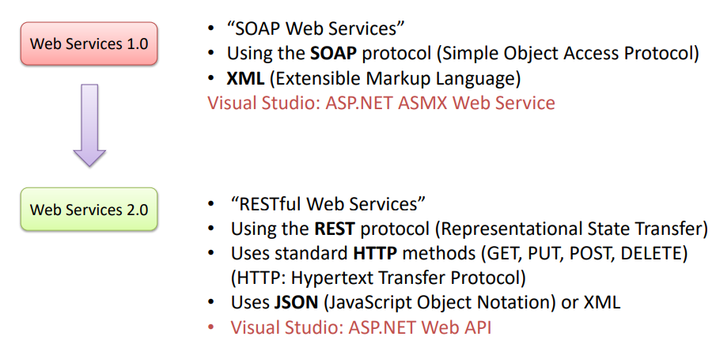
Types of web service

Slide 41
SOAP Web Services
SOAP stands for Simple Object Access Protocol. It is a XML-based protocol for accessing web services.
SOAP is a W3C recommendation for communication between two applications.
SOAP is XML based protocol. It is platform independent and language independent. By using SOAP, you will be able to interact with other programming language applications.

Slide 42
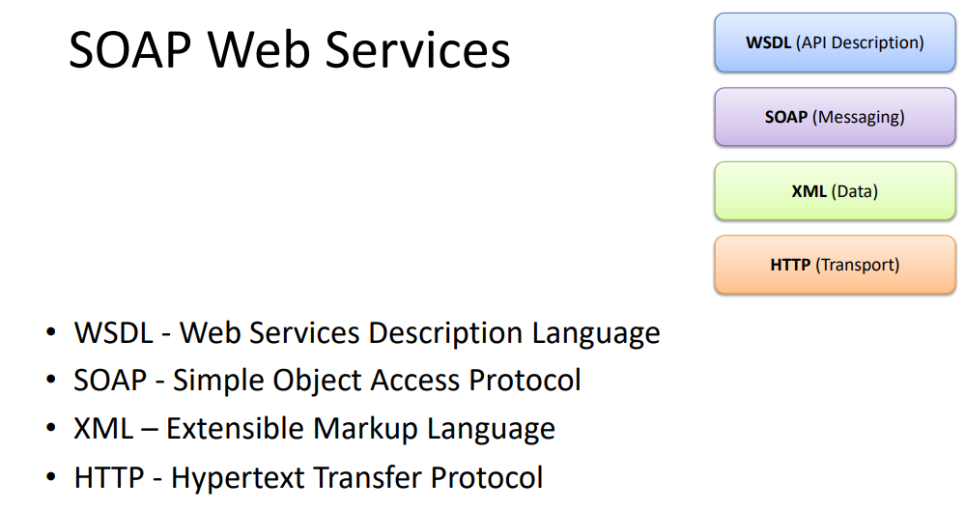

Slide 43
Advantages - Disadvantages
WS Security: SOAP defines its own security known as WS Security.
Language and Platform independent: SOAP web services can be written in any programming language and executed in any platform.
Disadvantages
Slow: SOAP uses XML format that must be parsed to be read. It defines many standards that must be followed while developing the SOAP applications. So it is slow and consumes more bandwidth and resource.
WSDL dependent: SOAP uses WSDL and doesn't have any other mechanism to discover the service.

Slide 44
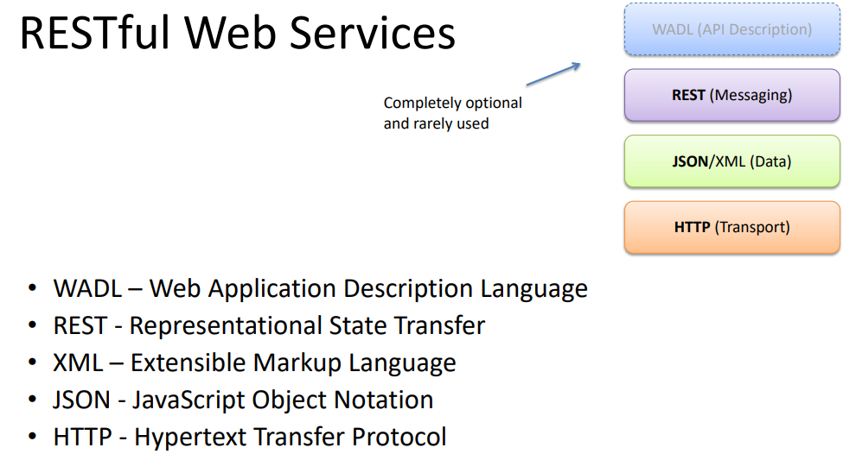
RESTful Web Services
REST stands for REpresentational State Transfer.
REST is an architectural style not a protocol.

Slide 45
Advantages
Fast: RESTful Web Services are fast because there is no strict specification like SOAP. It consumes less bandwidth and resource.
Language and Platform independent: RESTful web services can be written in any programming language and executed in any platform.
Can use SOAP: RESTful web services can use SOAP web services as the implementation.
Permits different data format: RESTful web service permits different data format such as Plain Text, HTML, XML and JSON.

Slide 46
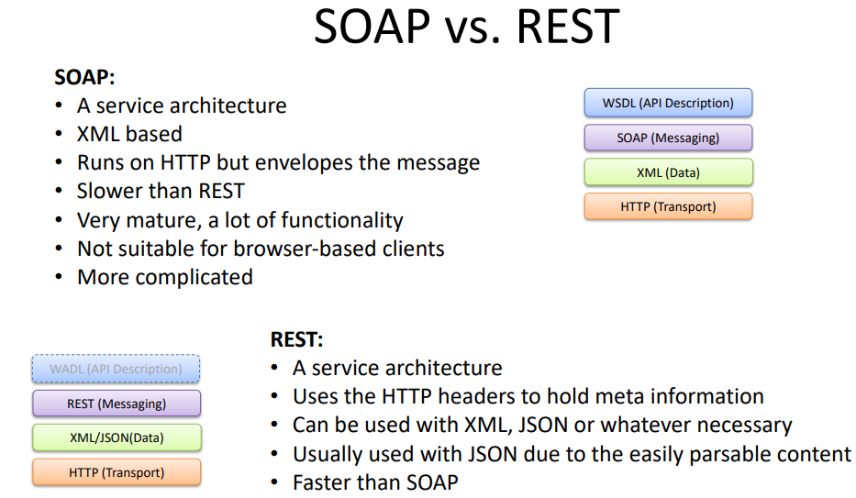

Slide 47
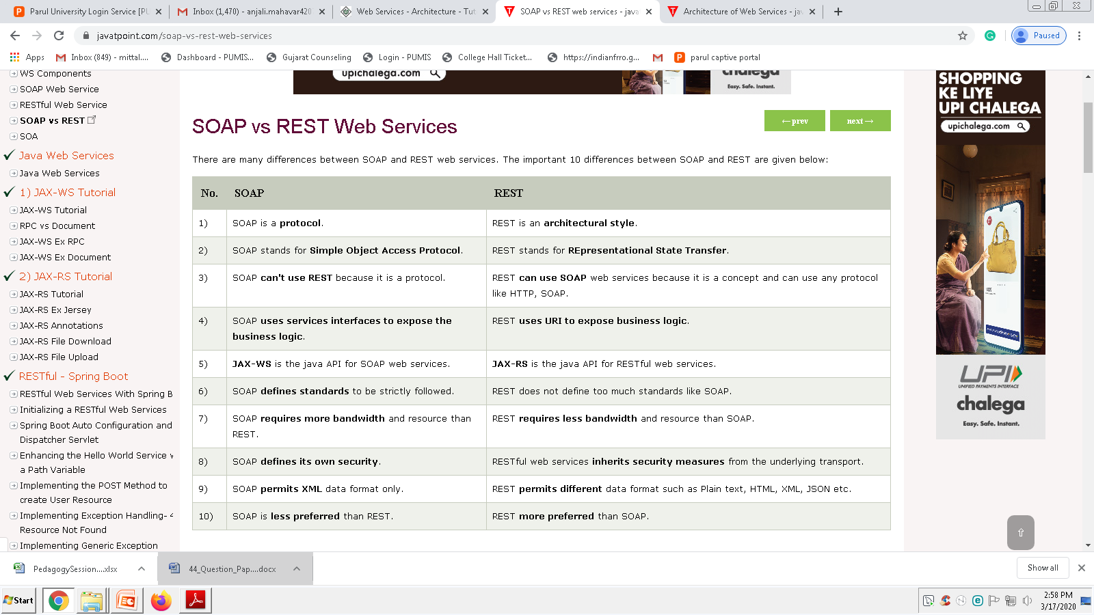
Soap Vs Rest

Slide 48
RESTful Web Services
REST (Representational State Transfer) follows an architectural style that enables communication between client and server applications over the web.
In REST-based web services, everything is treated as a resource, accessible via a unique URL.
RESTful web services facilitate interaction between software applications running on different platforms and frameworks.

Slide 49
RESTful Web Services
These services operate on a code-on-demand principle, where clients can execute logic from the server if needed.
A RESTful web service is invoked by sending an HTTP request to a specific URL, and the response contains the result.
The Jersey framework simplifies the development of RESTful web services in Java, making it an efficient tool for building REST APIs.

Slide 50
RESTful Architectural Principles
Statelessness: Each request is independent and must contain all necessary information.
Client-Server: Client and server are separate and communicate via standard protocols.
Uniform Interface: Standardized conventions for interacting with resources.
Cacheability: Responses can be cached to improve performance.

Slide 51
RESTful Architectural Principles
Layered System: The system is composed of multiple layers, each with specific responsibilities.
Code on Demand (optional): Servers can send executable code to clients for additional functionality.
Resource-Based: Everything is treated as a resource, and operations are performed on resources using HTTP methods.

Slide 52
HTTP Methods & URI Matching
GET: Retrieve data.
POST: Submit data.
PUT: Update data.
DELETE: Remove data.
Example URI pattern: /api/students/{id}

Slide 53
URI Matching
URI Patterns:
Collection URIs: These represent a group of resources. For example:
GET /users → A request to retrieve all users.
POST /users → A request to create a new user.
Single Resource URIs: These represent a specific instance of a resource. For example:
GET /users/{id} → A request to retrieve a specific user by ID.
PUT /users/{id} → A request to update a specific user by ID.
DELETE /users/{id} → A request to delete a specific user by ID.

Slide 54
Continue..
URL Parameters: Example:
GET /users?age=25 → Retrieve users that are 25 years old (query parameter).
In RESTful web services:
HTTP methods define the type of action (operation) to be performed on a resource.
URIs identify the resource (or collection of resources) on which the operation is to be performed.
The combination of these methods and URIs forms the foundation of how RESTful APIs operate, ensuring that operations on resources are clear, consistent, and standardized across the web.

Slide 55
JAX-RS Injection
@PathParam: Extracts values from URI path.
@QueryParam: Retrieves query parameters.
@FormParam: Captures form input data.
Example
@Path("/students")
public class StudentResource {
@GET
@Path("{id}")
public String getStudent(@PathParam("id") int id) {
return "Student ID: " + id; }
}

Slide 56
Server Responses & Exception Handling
Response Codes:
200 OK: Successful request.
201 Created: Resource created.
400 Bad Request: Invalid input.
500 Internal Server Error: Server issue.
Handling Exceptions:
@Provider
public class CustomExceptionMapper implements ExceptionMapper<Exception> {
public Response toResponse(Exception ex) {
return Response.status(500).entity(ex.getMessage()).build(); }
}

Slide 57
JAX-RS Client API
Used to make REST calls from Java applications.
Example:
Client client = ClientBuilder.newClient();
WebTarget target = client.target("http://example.com/api/students/1");
String response = target.request(MediaType.TEXT_PLAIN).get(String.class);
System.out.println(response);

Slide 58
JAX-RS Client API
The JAX-RS Client API simplifies the task of consuming RESTful web services from a Java application.
It abstracts the details of HTTP request/response handling and provides a clean, fluent interface to interact with REST APIs.
With support for asynchronous requests, request customization, and easy error handling, it’s an excellent choice for integrating RESTful APIs into Java applications.

Slide 59
Thank You

